Slide 1
Poor Economics
Abhijit Banerjee and Esther Duflo

Slide 2
The “received view” of poverty:
Poverty is primarily about hunger:
Almost all public assistance programs globally concern the distribution of food
In the global consciousness, poverty and hunger are synonymous.
In most places (including the US) the poverty line is calculated as a function of the costs of food.

Slide 3
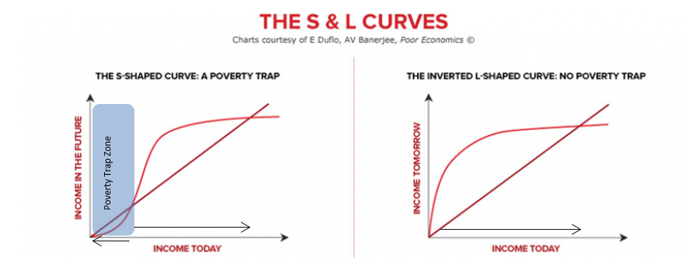
Poverty Traps:

Slide 4
A hunger-based poverty trap?
Imagine that you don’t earn enough money to properly nourish yourself. It is plausible to think that this means you will be unable to work as effectively tomorrow, which means less pay in the future than today, making your nutritional situation worse, and so on.
This is a hunger-based poverty trap.

Slide 5
Do the poor eat as much as they can?
If the picture of the relationship between poverty and hunger is as commonly assumed, then it would follow that the poor would eat as much as they can.

Slide 6
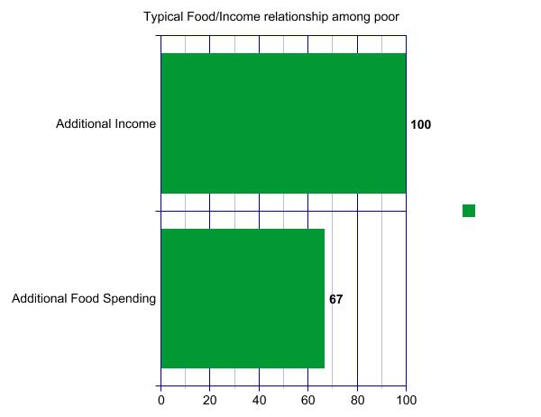
Do the poor eat as much as they can?

Slide 7
Do the poor eat as much as they can?
More income generally means better tasting food rather than more calories.
Banerjee and Duflo found that in India, more income meant more spending on wheat, rice, and sugar, which are more expensive per calorie than millet.
Jensen and Miller found that in China, when randomly selected poor households were offered subsidized wheat or rice, their consumption of these staples decreased, and total caloric intake remained constant or even decreased.

Slide 8
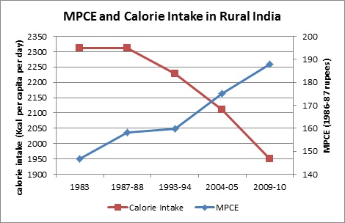
Do the poor eat as much as they can?

Slide 9
Are the poor irrational?

Slide 10
Are the poor irrational?
This is a dubious starting place. Individuals are occasionally irrational, but entire populations are not systematically irrational.

Slide 11
Are the poor irrational?
This is a dubious starting place. Individuals are occasionally irrational, but entire populations are not systematically irrational.
Bannerjee and Duflo begin with the premise that the poor know what they are doing and have some reason(s) for it.

Slide 12
Are the poor irrational?
This is a dubious starting place. Individuals are occasionally irrational, but entire populations are not systematically irrational.
Bannerjee and Duflo begin with the premise that the poor know what they are doing and have some reason(s) for it.
What could those reasons be?

Slide 13
An Abundance of Calories
In today’s world, there are plenty of calories for everyone.

Slide 14
An Abundance of Calories
In today’s world, there are plenty of calories for everyone.
Except in rare circumstances, sufficient calories for survival are easily affordable, even for those subsisting on less than $1 PPP per day.

Slide 15
An Abundance of Calories
In today’s world, there are plenty of calories for everyone.
Except in rare circumstances, sufficient calories for survival are easily affordable, even for those subsisting on less than $1 PPP per day.
This means that there are very few in the hunger-based poverty trap, even among the world’s poorest. (In 2004, only 2% of the world’s poorest said they did not have enough food)

Slide 16
Is this the whole story?
It seems like there is still room to look for some form of poverty trap that has something to do with food, but that doesn’t stem from a simple lack of calories.
Consider the following:

Slide 17
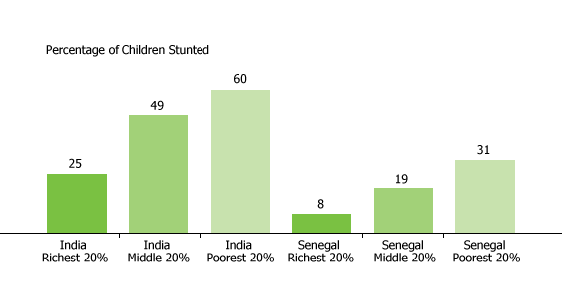
Height by Income

Slide 18
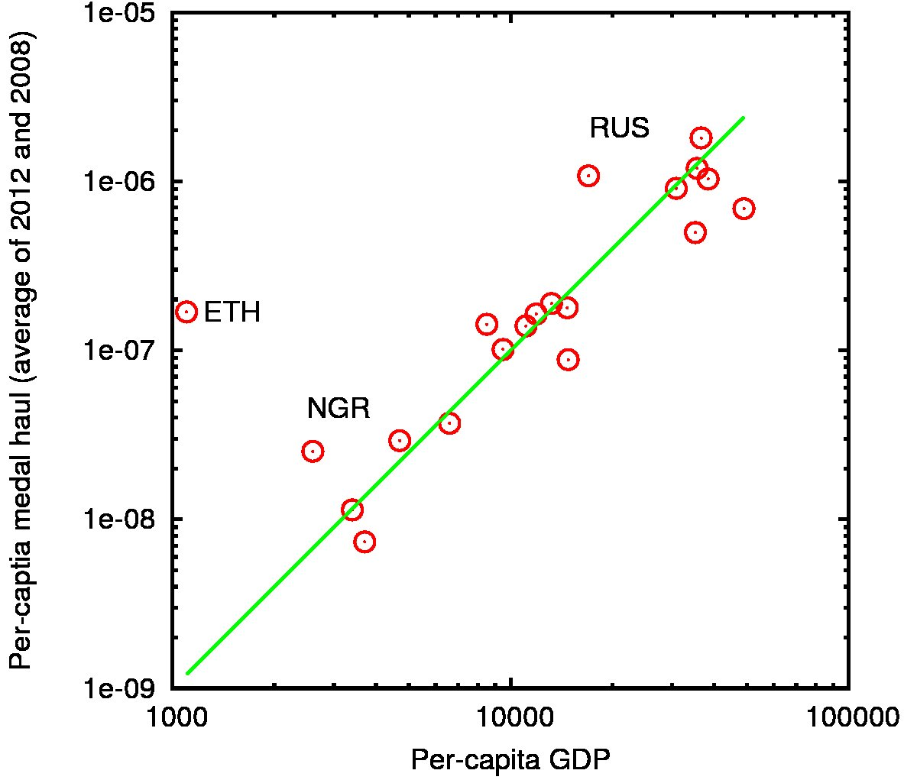
Olympic medals per capita by GDP

Slide 20
All-time Bangladesh Medal Count:

Slide 21
All-time Bangladesh Medal Count:
0

Slide 22
Anemia:
Anemia is primarily due to a lack of dietary iron, which is usually gained by eating meat. Anemia causes lethargy, weakness, low aerobic capacity.

Slide 23
Anemia:
Anemia is primarily due to a lack of dietary iron, which is usually gained by eating meat. Anemia causes lethargy, weakness, low aerobic capacity.
Iron is a micronutrient.

Slide 24
Anemia:
Anemia is primarily due to a lack of dietary iron, which is usually gained by eating meat. Anemia causes lethargy, weakness, low aerobic capacity.
Iron is a micronutrient.
Iron supplements could be very cheaply available even among the world’s poorest ($7 PPP per year)

Slide 25
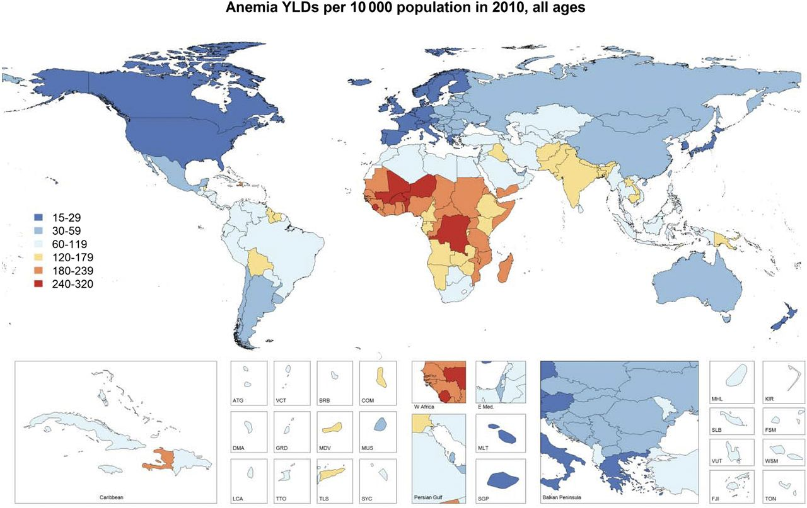

Slide 26
A micronutrient based poverty trap:
A lack of productivity can make a diet more basic, which in turn makes an individual less productive.

Slide 27
A micronutrient based poverty trap:
A lack of productivity can make a diet more basic, which in turn makes an individual less productive.
Despite the availability and low cost of nutritional supplements, they are not in widespread use.

Slide 28
Why do the poor resist attempts to improve their nutrition?

Slide 29
Why do the poor resist attempts to improve their nutrition?
Lack of obvious evidence of effectiveness.

Slide 30
Why do the poor resist attempts to improve their nutrition?
Lack of obvious evidence of effectiveness.
Distrust of strangers telling you what to eat.

Slide 31
Why do the poor resist attempts to improve their nutrition?
Lack of obvious evidence of effectiveness.
Distrust of strangers telling you what to eat.
Different priorities

Slide 32
More important than food
The consumption of cheap calories is associated with being poor.

Slide 33
More important than food
The consumption of cheap calories is associated with being poor.
When the poor have extra income, they tend to spend it on things that make life more worthwhile:

Slide 34
More important than food
The consumption of cheap calories is associated with being poor.
When the poor have extra income, they tend to spend it on things that make life more worthwhile:
Festivals
Television
Special, better-tasting foods
Clothing
Art and craft

Slide 35
So What IS Poverty?
Poverty is not a lack of calories, though a lack of quality nutrients seems to play a significant role

Slide 36
So What IS Poverty?
Poverty is not a lack of calories, though a lack of quality nutrients seems to play a significant role
Modern Poverty is not a condition of absolute deprivation, but of relative inequality.

